Slide 1
Term Project - Video Demo and Presentation
Intro to Artificial Intelligence
ALGORITHM EXPLORER
Andre Glasnovic,
Sai Mohan Majoju,
SaiKumar Jakkula,

Slide 2
Algorithm Explorer
Aim of the project BFS Algorithm DFS Algorithm A* Algorithm
Analysis

Slide 3
Aim of the project
The aim of the project is to find the path of the goal node by avoiding the obstacles using different algorithms.
To find the path from a start node to a goal node in a grid using Breadth first search, Depth first search and A* algorithms.

Slide 4
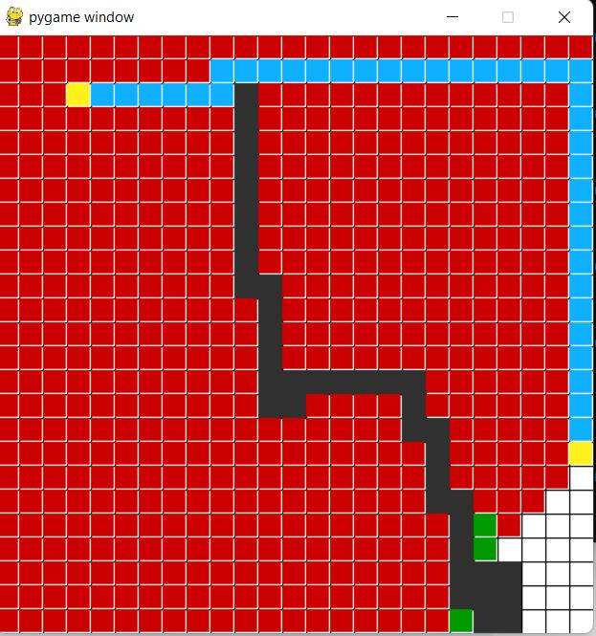
BFS Algorithm
Breadth First search is also an example of a brute-force search algorithm.
BFS, unlike DFS, explores all nodes nearest to root nodes before exploring nodes furthest away.
Time complexity: O(|V|+|E|)
BFS Algorithm Applications
To build index by search index
For GPS navigation
Path finding algorithms
Cycle detection in an undirected graph

Slide 5
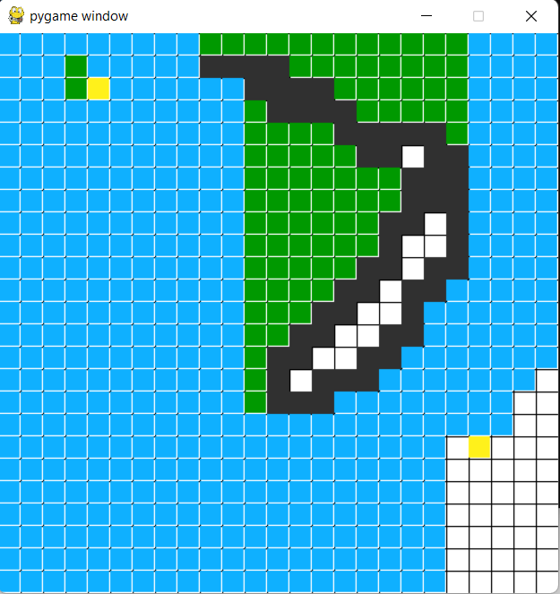
DFS Algorithm
Depth first Search or Depth first traversal is a recursive algorithm for searching all the vertices.
DFS keeps walking down a path until it is forced to backtrack. It backtracks until it finds a new path to go down.
Time complexity: O(|V|+|E|)
DFS Algorithm Applications
For finding the path
To test if the graph is bipartite
For finding the strongly connected components of a graph.
For detecting cycles in a graph

Slide 6
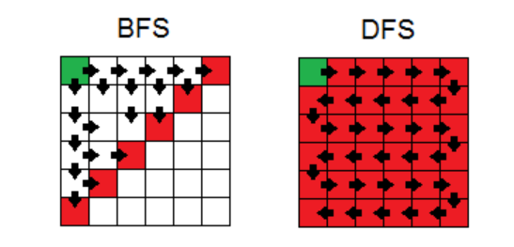
Visual representation

Slide 7
A* ALgorithm
A* Search algorithms, unlike other traversal techniques, it has “brains”. What it means is that it is really a smart algorithm which separates it from the other conventional algorithms.
A* Algorithm extends the path that minimizes the following function-
f(n) = g(n) + h(n)
Here, ‘n’ is the last node on the path
g(n) is the cost of the path from start node to node ‘n’
h(n) is a heuristic function that estimates cost of the cheapest path from node ‘n’ to the goal.

Slide 8


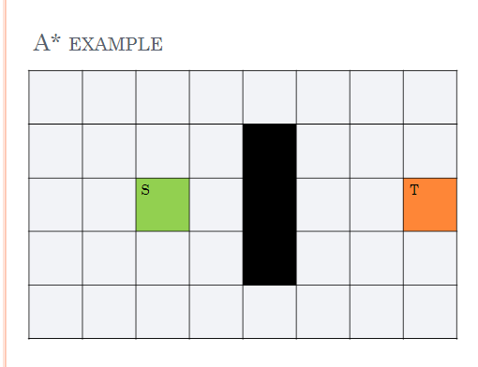
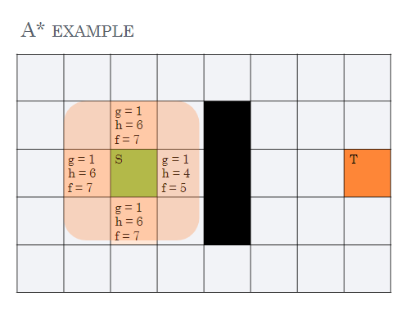
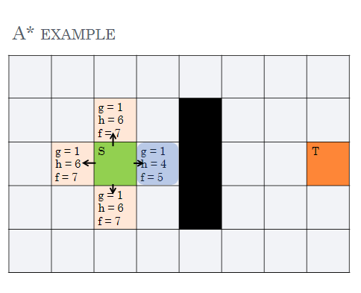
A* TRaversal

Slide 9
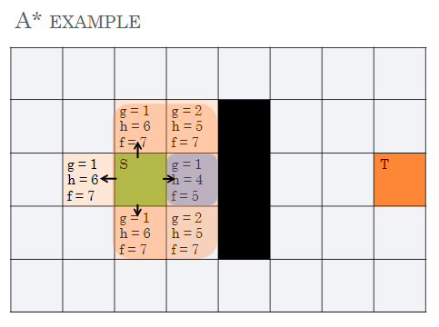
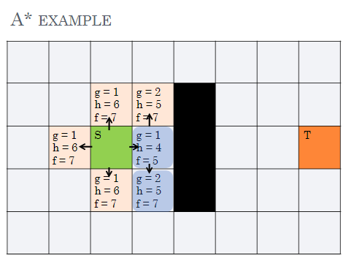
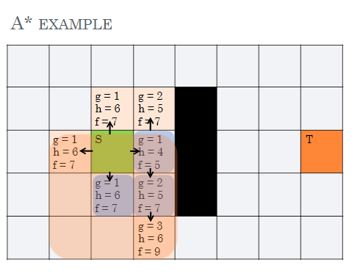

Slide 10
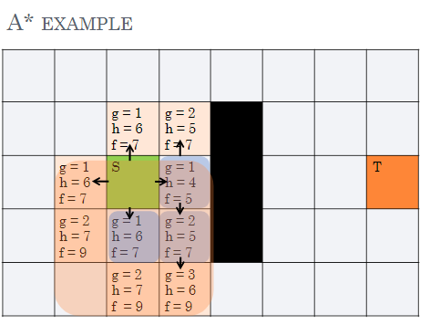
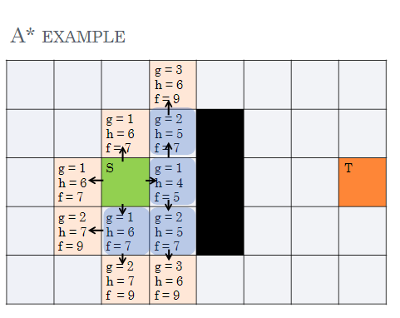
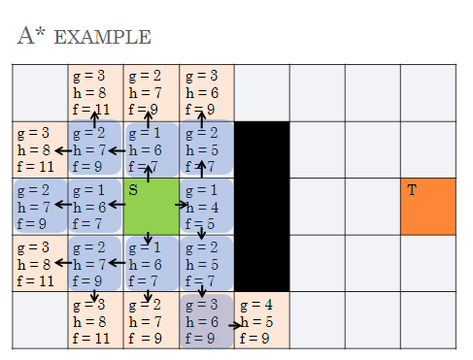

Slide 11
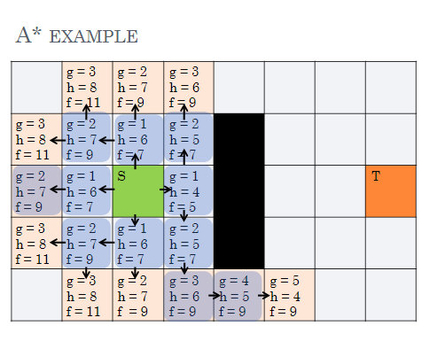
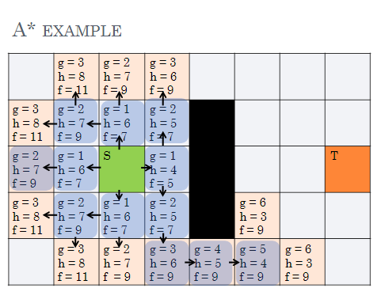
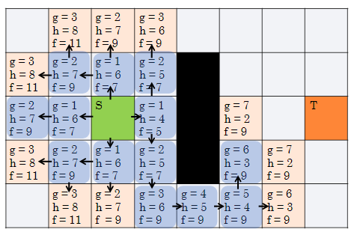

Slide 12
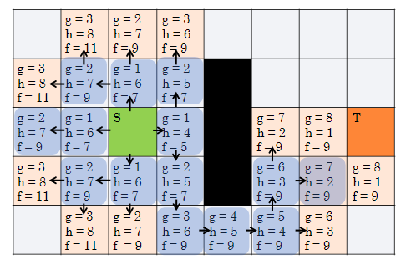
Goal State

Slide 13
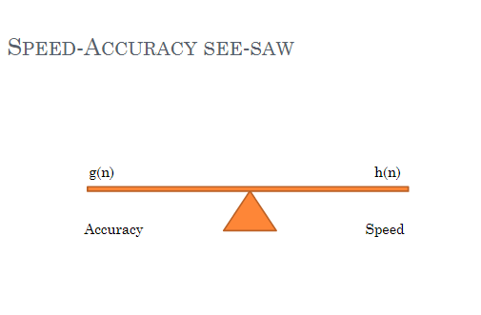
SPEED ACCURACY

Slide 14
Grid traversal
Grid allows movement between adjacent cells in 4 or 8 possible directions.
Each direction may have a different cost.
In this game all horizontal and vertical costs are the same.

Slide 15
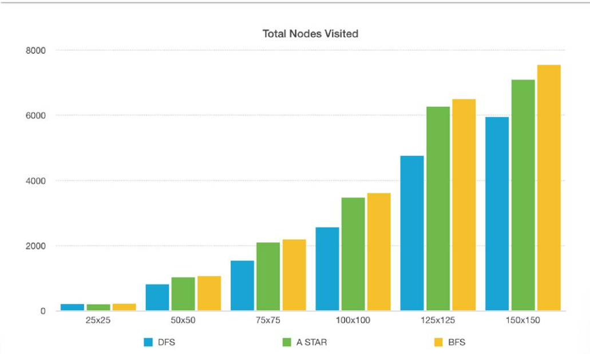
Analysis
Nodes visited vs Grid size

Slide 16
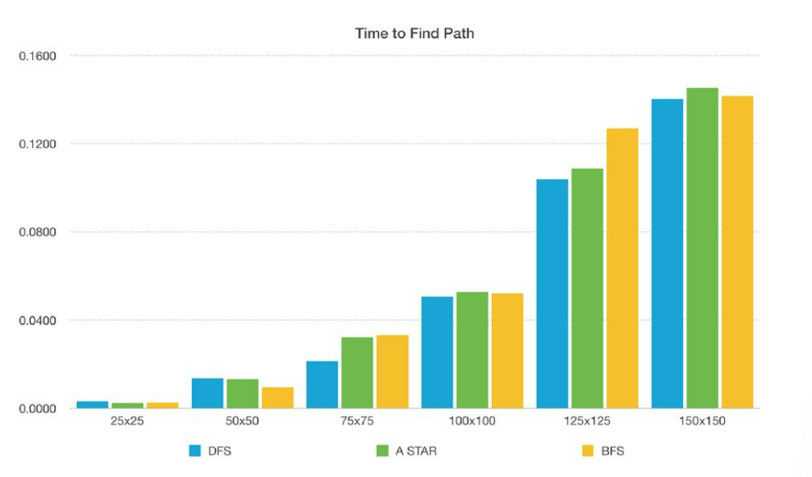
Time vs Grid size

